Slide 1
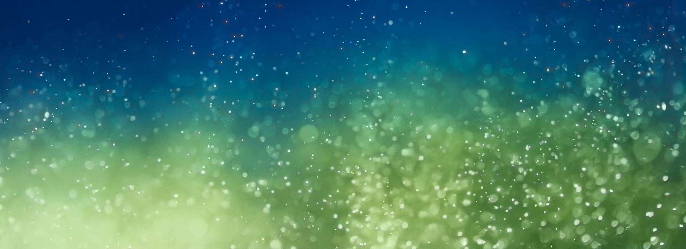
Sonification of Gravitational Wave GW200129_065458
Kaitlynn Sutherland

Slide 2
Motivation
Use gravitational waves to hear the sound of two black holes merging

Slide 3
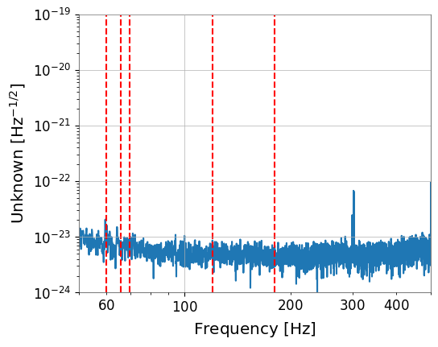
GPS: 1264316116.4
Filtered at 60, 65.8, 69.8, 120 and 180

Slide 4
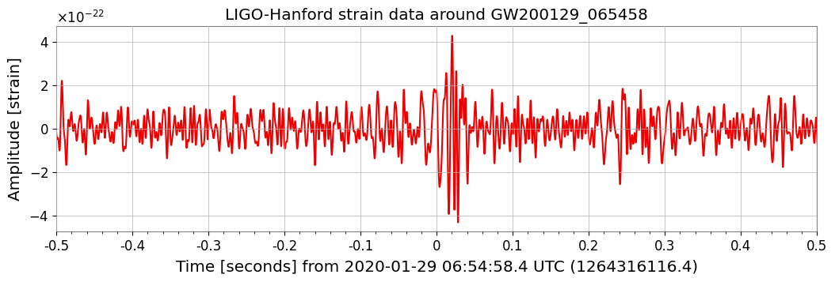
Filtered frequency of the merger event alone
Zoomed into the peak, on x-axis from -0.5 to 0.5

Slide 5
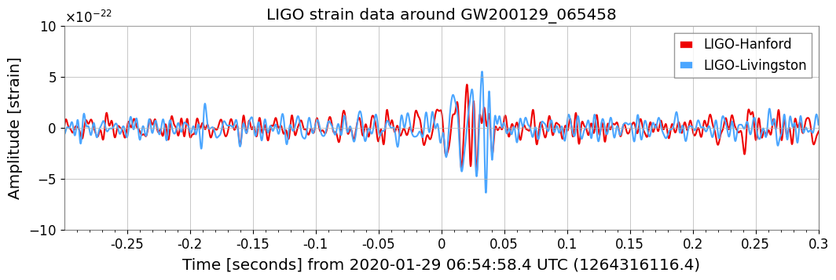
Comparison of Livingston and Hanford LIGO data during the event to determine if the merger event was real

Slide 6
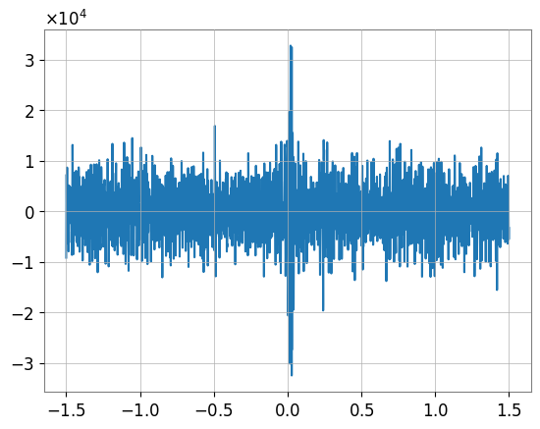
Visual representation of sound wave

Slide 7
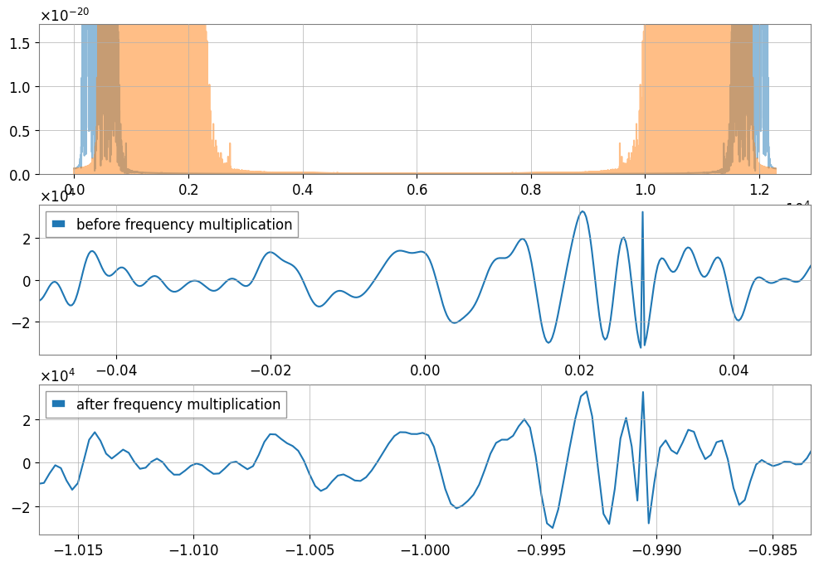
Make clip 1.5 sec
Increase the frequency by 3
Make signal more distinct from the noise
Make sound more audible

